Slide 1

DEPARTMENT OF INFORMATION TECHNOLOGY
SCHOOL OF COMPUTING
1156IT701- MAJOR PROJECT
INTERNSHIP THROUGH DIND/PLACEMENT/ABROAD
WINTER SEMESTER(2023-2024)
REVIEW - I
“CERT+”
SUPERVISED BY
Mrs. J. Deepa
M.E.
PRESENTED BY
1. Prashant Kumar Singh (VTU16998)(20UTIT0042)

Slide 2
AGENDA
ABSTRACT
OBJECTIVE
INTRODUCTION
LITERATURE REVIEW
DESIGN AND METHODOLOGIES
CONCLUSION
OFFER LETTER SOFT COPY/SCANNED COPY
INDUSTRY DETAILS

Slide 3
ABSTRACT
CERT+ and ADC+ by AppViewX offer comprehensive solutions for secure certificate management and application delivery control. CERT+ ensures efficient management of digital certificates, enhancing security and compliance. ADC+ streamlines application delivery, providing advanced traffic management and security features. Together, they empower organizations with robust tools for a secure and optimized IT infrastructure.

Slide 4
OBJECTIVES
Aim of the Project:
CERT+ automates certificate lifecycle management, bolstering cybersecurity and achieving crypto-agility.
ADC+ optimizes application delivery, simplifying load balancing across multi-vendor environments for improved performance and reliability.
Scope of the Project:
CERT+ and ADC+ streamline certificate lifecycle management and application delivery control, respectively, across diverse environments, enhancing cybersecurity posture, maintaining compliance, optimizing performance, and ensuring seamless user experiences across multi-vendor setups.

Slide 5
INTRODUCTION
CERT+ by AppViewX is a cutting-edge solution for efficient certificate lifecycle management. With its intuitive interface and automation capabilities, CERT+ simplifies the issuance, renewal, and revocation of digital certificates. Enhanced security and compliance are achieved through centralized visibility, policy enforcement, and streamlined workflows, making it an essential tool for modern cybersecurity strategies.

Slide 6
LITERATURE REVIEW
Jones et al. (2020) emphasized the critical role of proper certificate lifecycle management (CLM) in mitigating cybersecurity risks. In their study, they highlighted how outdated or expired certificates can lead to data breaches and system vulnerabilities, stressing the need for automated CLM solutions.
Smith and Johnson (2018) discussed the challenges organizations face in maintaining a secure and compliant IT environment. Their research emphasized the importance of a comprehensive CLM strategy to prevent certificate-related outages and ensure regulatory compliance.

Slide 7
LITERATURE REVIEW
Lee and Kim (2021) explored the increasing complexity of certificate ecosystems in today's digital landscape. Their research highlighted the challenges of managing diverse certificates across hybrid environments.
Chen et al. (2017) discussed the evolving threat landscape and the rise of certificate-related attacks. They emphasized the importance of continuous monitoring and timely renewal of certificates to prevent unauthorized access.

Slide 8
DESIGN AND METHOLOGIES
MODULE 1: Need for CERT+
MODULE 2: Features of CERT+

Slide 9
MODULE:1
Why CERT+?
Efficient Management:
Automates certificate lifecycle tasks.
Saves time and reduces errors.
Compliance Assurance:
Ensures certificates meet industry standards.
Avoids penalties and maintains trust.
Visibility and Control:
Centralized view of all certificates.
Better monitoring and risk identification.
Risk Mitigation:
Quickly responds to security incidents.
Minimizes impact of cyber attacks.
Streamlined Operations:
Frees up IT resources from manual tasks.
Allows focus on strategic initiatives.

Slide 10
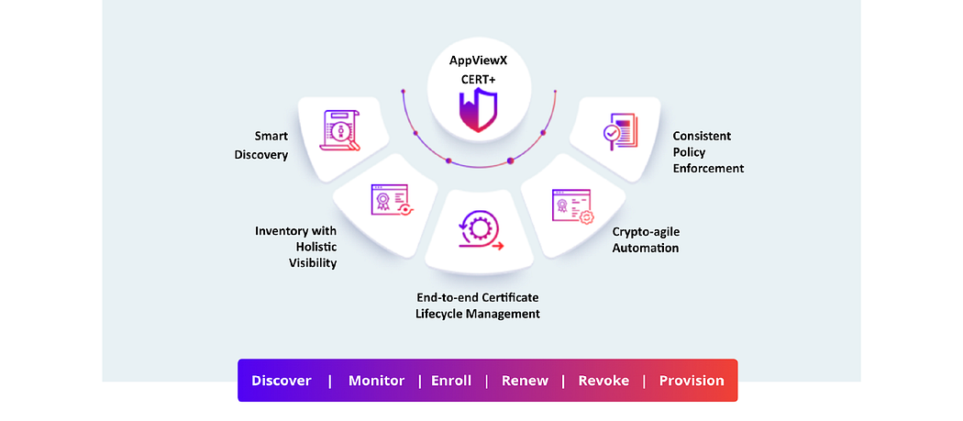
IMPLEMENTATION

Slide 11
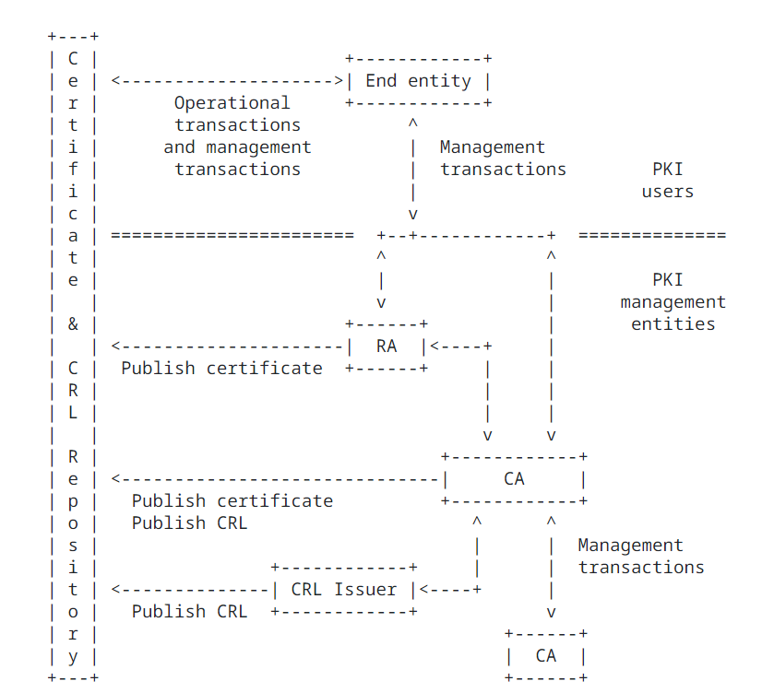
ARCHITECTURE DIAGRAM

Slide 12
CONCLUSION
In conclusion, CERT+ by AppViewX streamlines secure certificate management, ensuring compliance with industry standards. Its automation simplifies tasks like issuance and renewal while providing centralized visibility for proactive monitoring. CERT+ empowers IT teams to focus on strategic initiatives, enhancing overall security and operational efficiency in today's digital environment.

Slide 13
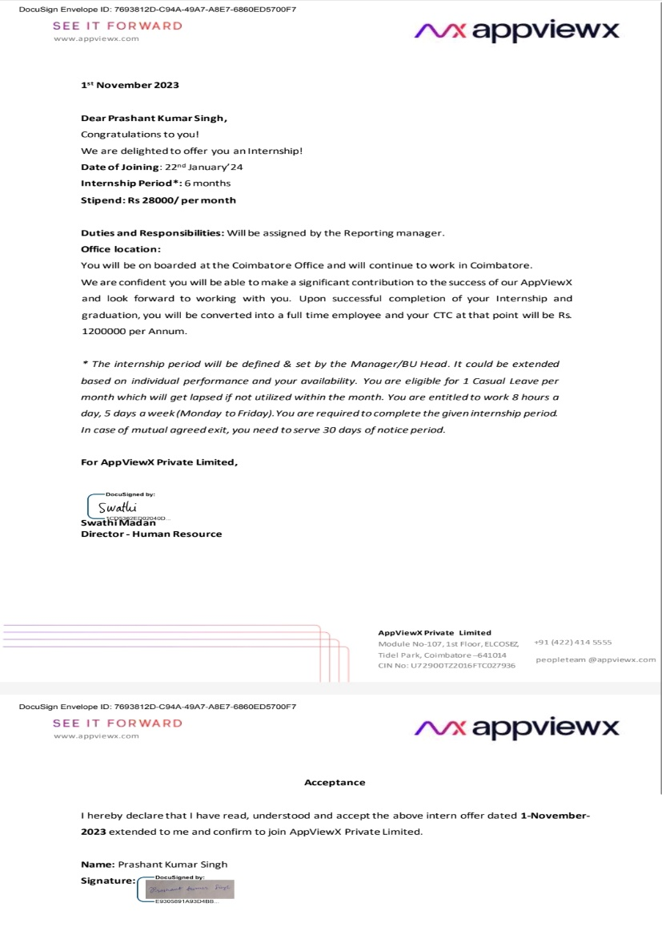
OFFER LETTER SOFT COPY/SCANNED COPY

Slide 14
INDUSTRY DETAILS
Industry Guide Name: Ganesh Gopalan
Industry Guide phone number: 9444208384
Industry Guide mail Id: ganesh.gopalan@appviewx.com
Industry Location: Module No: 107, 1st Floor, ELCOT SEZ, Tidel Park, Coimbatore, Tamil Nadu – 641014
Duration of Internship: 6 Months (Jan 24 – Aug 24)
Date of Reporting to Industry

Slide 15
THANK YOU

